Slide 1



Project Phase – 1
“AI Deep Forge: An Integrated Unimodel for Digital Forensics in AI-Generated Content”
Asiyamath Azeema 4BP22AD008
Ayishath Safa 4BP22AD010
Fathima Anna 4BP22AD015
Sumaiya Naseer Husen Sarwad 4BP22AD051
Guide: Soudha N
Department of Artificial Intelligence and Data Science
BEARYS INSTITUTE OF TECHNOLOGY
Lands End, Innoli, Mangaluru – 574199
MAY, 2025

Slide 2
Contents:
Introduction
Literature Review
Research Gap
Statement of the Problem
Objectives of Study
Research Design and Methodology
Flowchart
Snapshots & Time plan
References
Future work
Conclusion

Slide 3
Introduction
Deepfakes are Al-generated synthetic media where a person's face or voice is altered to appear as someone else.
﻿This technology can be misused for misinformation, fraud, and defamation.
﻿There is an urgent need for forensic systems to verify the authenticity of digital visual content.
﻿The goal is to design a robust and deployable system for deepfake detection.

Slide 4
Literature Review
No. | Title | Authors | Key Contribution | Year
1 | Xception: Deep Learning with Depthwise Separable Convolutions | François Chollet | Introduced Xception CNN model with depthwise separable convolutions. | 2017
2 | MesoNet: A Compact Facial Video Forgery Detection Network | Afchar et al. | Proposed a small CNN for fast deepfake detection. | 2018
3 | FaceForensics++: Learning to Detect Manipulated Facial Images | Rössler et al. | Provided a large dataset for manipulated facial video detection. | 2019
4 | Two-Stream Neural Networks for Tampered Face Detection | Nguyen et al. | Introduced two-stream CNN to detect facial forgeries. | 2019

Slide 5
Literature Review
No. | Title | Authors | Key Contribution | Year
5 | DeepFake Detection using Spatiotemporal Convolutional Networks | Sabir et al. | Used CNN+RNN architecture to learn temporal features. | 2019
6 | Detecting GAN-Generated Fake Images using Co-occurrence Matrices | Nataraj et al. | Proposed detecting GAN-generated images using co-occurrence matrices. | 2019
7 | Fighting Deepfakes: Detection Using CNN-LSTM Architecture | Amerini et al. | Combined CNN with LSTM for video deepfake detection. | 2020
8 | Real-Time Deepfake Detection using EfficientNet | Dang et al. | Applied EfficientNet for lightweight and real-time deepfake detection. | 2021

Slide 6
Research Gaps
Most existing models focus purely on image-based analysis, ignoring temporal (frame sequence) ,text and audio cues.
Limited integration of detection systems into realtime applications.
Models are often trained and evaluated on one manipulation method, lacking generalization across others (e.g., FaceSwap, Deepfakes, Face2Face).
Lack of user-friendly tools for common users to verify content authenticity.

Slide 7
Statement of the Problem
Current AI-forensic tools are limited in scope and specialization, making them insufficient to address the complex and integrated nature of synthetic media threats. There is an urgent need for a unified, modular system that can detect, analyze, and verify the authenticity of content across multiple modalities, including video, image, audio, and text.

Slide 8
Objectives of Study
Extract and preprocess data from the FaceForensics++ dataset.
Train a deep learning model (Xception-based CNN) to classify real vs. fake images.
Develop a web interface using Flask for easy user interaction.
Validate the model's performance using accuracy and confidence metrics.
Build a scalable pipeline that can be extended to other data modalities (e.g., audio, video sequences).

Slide 9
Research Design and Methodology
﻿Data Collection: Used the FaceForensics++ dataset, including real and manipulated videos.
﻿Frame Extraction: Up to 30 frames per video using OpenCV; resized to 299x299.
﻿Labeling: Frames categorised as real or fake based on their source.
Model Building :
Pretrained Xception model used as a base.
Custom top layers added: GlobalAverage Pooling, Dense(128), Dense(1, sigmoid).

Slide 10
Research Design and Methodology
Training:
ImageDataGenerator used for real-time data feeding and augmentation.
Binary crossentropy loss with Adam optimizer.
Training over 5 epochs with validation split.
Deployment：
Flask-based web application.
Users upload an image and receive prediction (Real/Fake)with confidence score.

Slide 11
Flowchart
START
AI Deep Forge System
REAL OR FAKE CLASSIFICATION
EXTRACT FRAMES FROM VIDEOS
PREDICT WITH TRAINED MODEL
PREPROCESSING FRAMES (RESIZING)
BUILD & TRAIN MODEL (XCEPTION CNN)

Slide 12
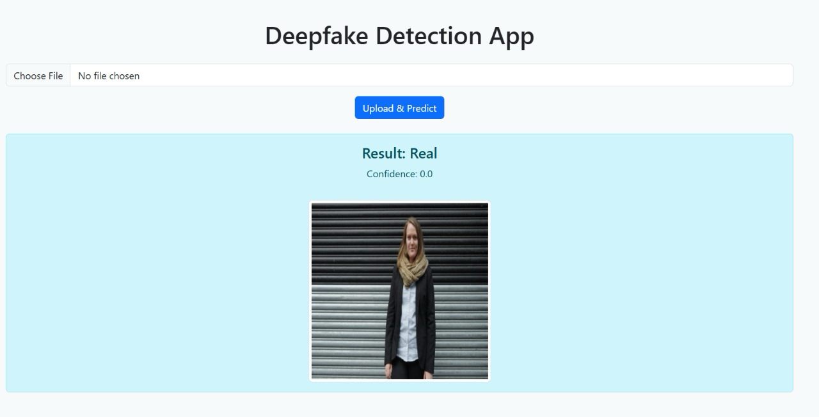
Snapshots

Slide 13
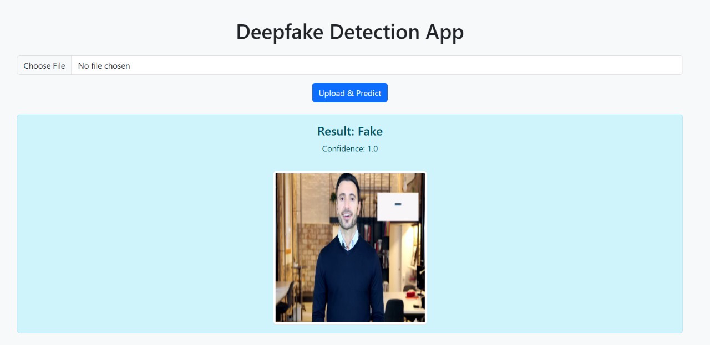
Snapshots

Slide 14
Time Plan
Week | Task
1–2 | Requirement gathering, architecture design
3–4 | Implement image and video modules (CNN, deepfake detection)
5 | Optimize CNN-based detection pipelines
6 | Integrate multimodal decision system
7 | Dataset preparation utility
8 | Testing and debugging
9 | Performance evaluation
10 | Documentation and final report

Slide 15
References
Chollet, F. Xception: Deep Learning with Depthwise Separable Convolutions, CVPR, 2017.
Afchar, D., et al. MesoNet: A Compact Facial Video Forgery Detection Network, WIFS, 2018.
Rössler, A., et al. FaceForensics++: Learning to Detect Manipulated Facial Images, ICCV, 2019.
Nguyen, H.H., et al. Two-Stream Neural Networks for Tampered Face Detection, arXiv, 2019.
Sabir, E., et al. Recurrent Convolutional Strategies for Face Manipulation Detection in Videos, CVPRW, 2019.
Nataraj, L., et al. Detecting GAN-Generated Fake Images using Co-occurrence Matrices, Electronic Imaging, 2019.
Amerini, I., et al. Deepfake Video Detection through Optical Flow Based CNN, ICPR, 2020.
Dang, H., et al. On the Detection of Digital Face Manipulation, CVPR, 2021.
TensorFlow and Keras documention
Dataset from GitHub

Slide 16
Future Work
﻿Include audio or temporal features for better accuracy.
﻿Integrate with mobile apps or browser extensions.
﻿Use advanced transformers or multimodal fusion.

Slide 17
Conclusion
﻿Effective pipeline from data extraction to deployment.
﻿Can detect deepfakes from individual frames.

Slide 18

Thank you

